Slide 1
Team 8 Final Project
Cheeky Beak Card Company Website

Slide 2
Team Members
Fontend Development
John Ator
Miles McLenon
Backend Development
Alex Wendte
Lane Sorell
Database Development
Colin Cope
Donny Riffel

Slide 3
Project Details
Cheeky Beak Card Company
Creates and sells cards for many circumstances
Wants a personal website to move off of Etsy
Requirements
Allow a user to sign in/create an account
Display the products that are available for purchase
Keep the items that the user has selected in a cart
Allow the user to place an order
Allow the owners to see placed orders

Slide 4
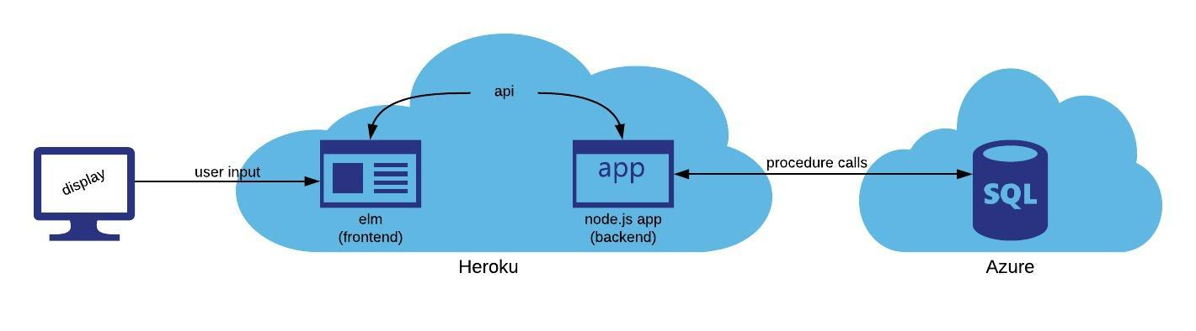
System Design

Slide 5
Demo
Go To: https://cis560final.herokuapp.com/
Purchasing
Admin Card Editing
Order and Summary Statistics

Slide 6
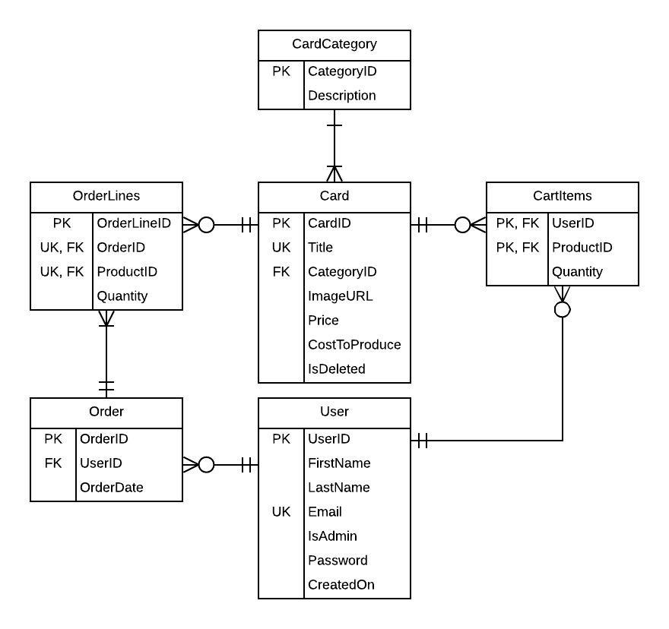
Database Design

Slide 7
Future Work
Security
Password hashing
Admin account creation (not handled on frontend)
Summary Information
Top Sellers List
CSS

Slide 8
Questions?

